Slide 1
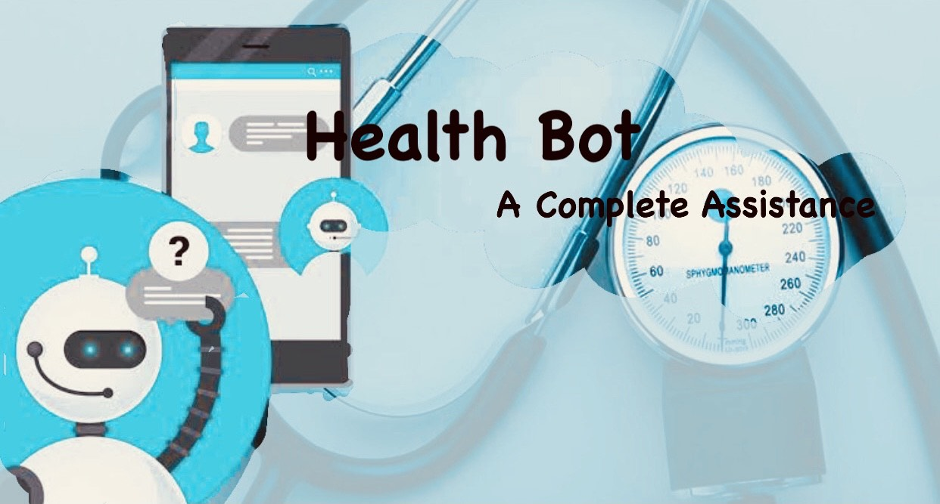

Slide 2
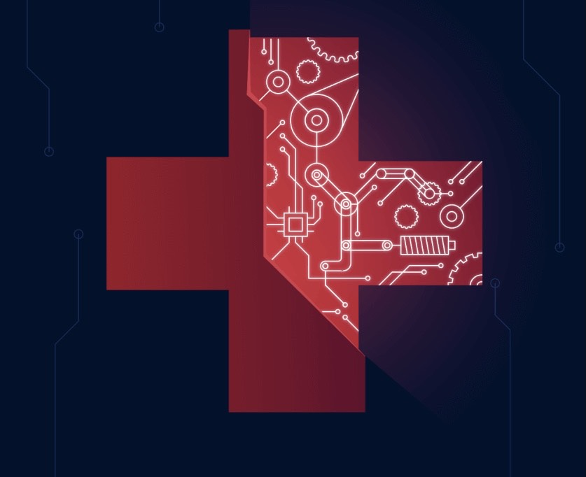
HEALTH BOT
SUPERVISOR:
Mrs.Supraja
TEAM MEMBERS:
G. Swapna (2453-18-733-084)
D. S. Shreya (2453-18-733-077)
T. Tharun Teja (2453-18-733-112)

Slide 3
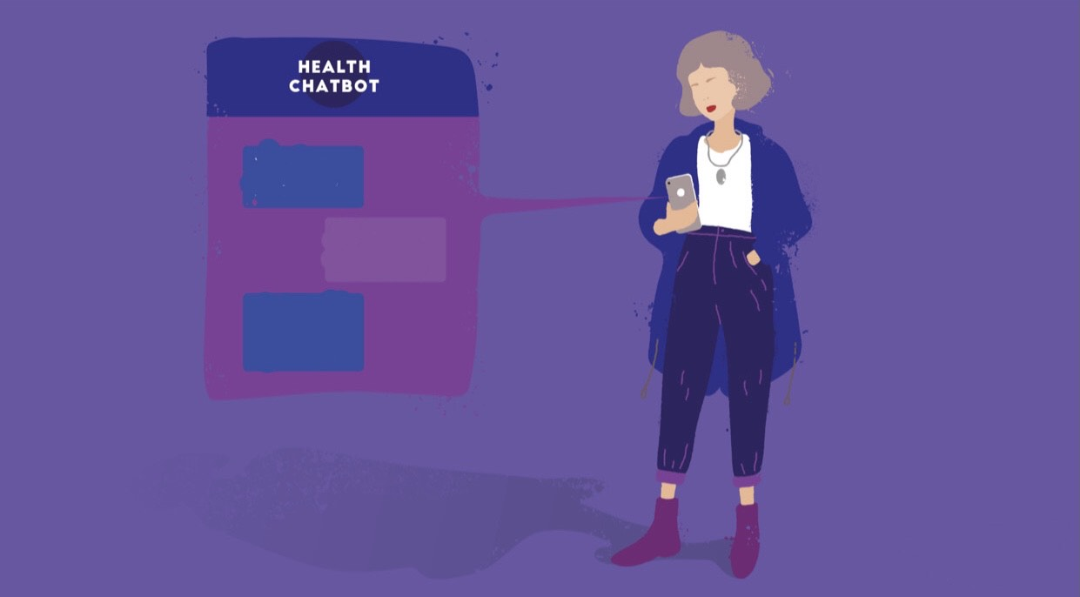
CONTENTS
Introduction
Importance and need of your project Design
Tools and Technologies Implementation
System/User requirements Contributions
System Design
Conclusion of the Project

Slide 4
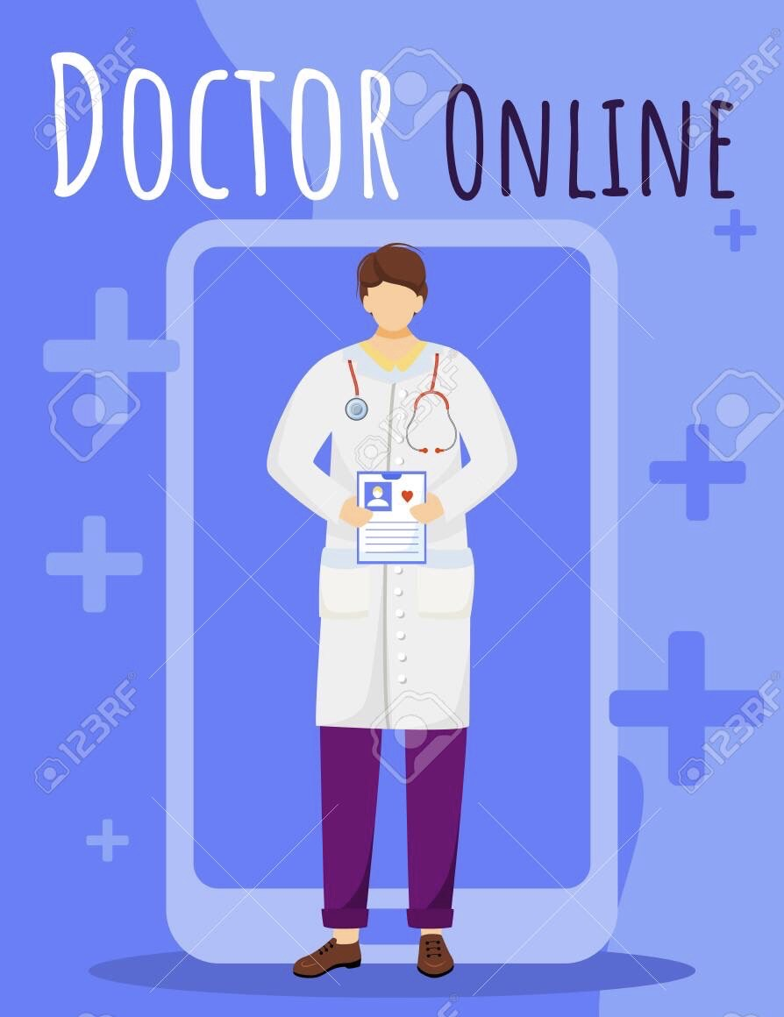
INTRODUCTION
The goal of our project is to introduce a Health Bot, a system designed to improve the e-health paradigm by using a Chat Bot to stimulate human interaction in medical context.
Its specifies various NLU and NLP techniques to be incorporated in the chat Bot and the comparison of the same.

Slide 5
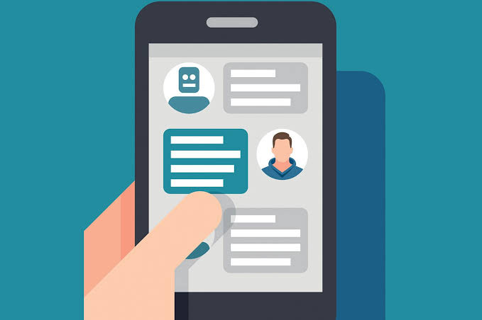
NLP refers to natural language processing. NLP creates systems that learns to perform tasks on their own and get better through experience.
NLU refers to natural language understanding. It is a technology that helps translate human language to machine or computer language and vise versa. NLU is similar to NLP the only difference is that NLU understands errors, spellings, accents, emotions, etc.

Slide 6

IMPORTANCE AND NEED OF THE PROJECT DESIGN
Our Bot creates a link between the patients and the hospital management leading to many advantages.
From providing 24/7 active customer support a Health Bot can upscale our business. Via this Bot, we can provide customers with relevant and personalized services.

Slide 7
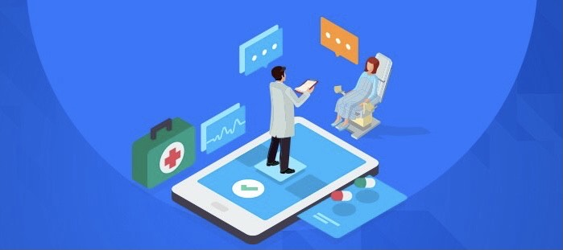
Also, we can track the interaction of the users with the Health Bot and analyze the best ways to pitch a service, without degrading the customer experience.
Health Bot can clear the queries of the users and remembers their preferences. By engaging with the users in real-time, this Bot makes it easy going for them to search and find suitable services

Slide 8

TOOLS AND TECHNOLOGIES USED
The following are the tools and technologies used while developing the project:
MongoDB: MongoDB is a document database with the scalability and flexibility that you want with the querying and indexing that you need. We have opted for MongoDB instead of SQL as it is almost 100 times faster than traditional database systems. Another Reason why we prefer MongoDB is because MongoDB supports deep query-ability i.e we can perform dynamic queries on documents using the document-based query language.

Slide 9
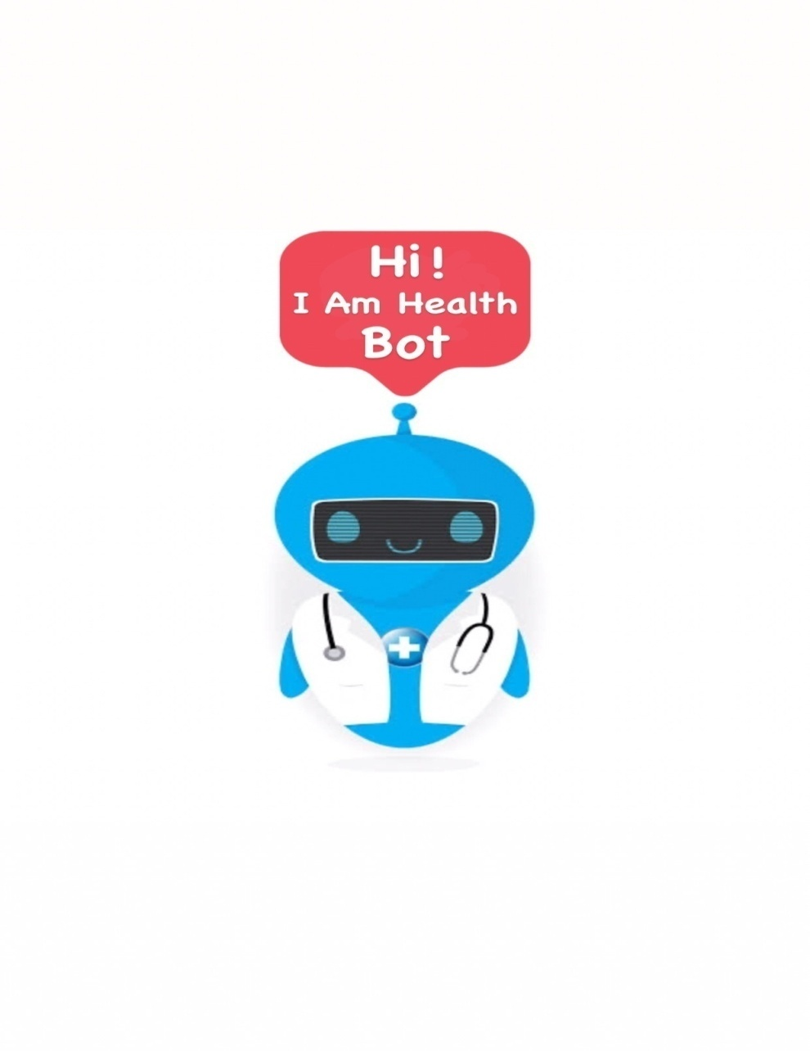
Google’s Dialogflow: Dialogflow is a natural language understanding platform. Its is faster when compared to other platforms. To add, connecting Dialogflow to other applications is efficient and has maximum reach. The major advantage of Dialogflow is that it provides the basic version for free.
Ngrok: Ngrok allows you to expose a web server running on your local machine to the internet.
NodeJS: Node.js is an open-source, cross-platform, back-end JavaScript runtime environment that runs on the Chrome engine and executes JavaScript code outside a web browser.

Slide 10
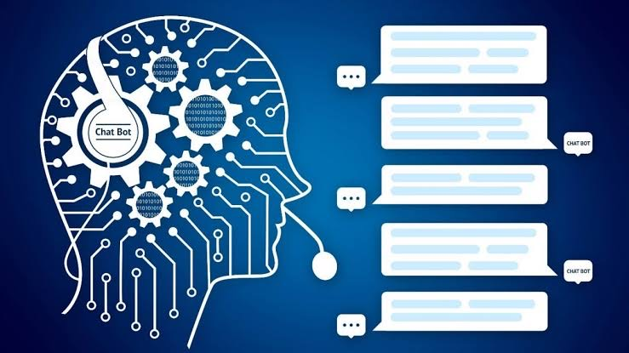
Visual Studios: Visual Studio Code is a free source-code editor made by Microsoft for Windows, Linux and macOS. Features include support for debugging, syntax highlighting, intelligent code completion, snippets, code refactoring, and embedded Git.

Slide 11
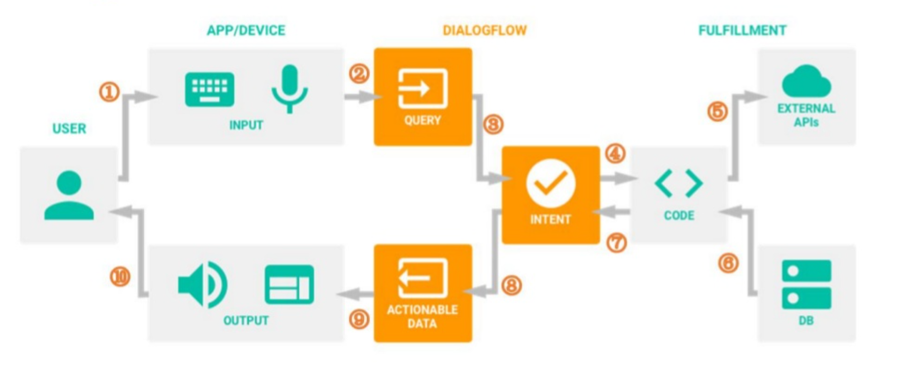
Working of Dialogflow:

Slide 12
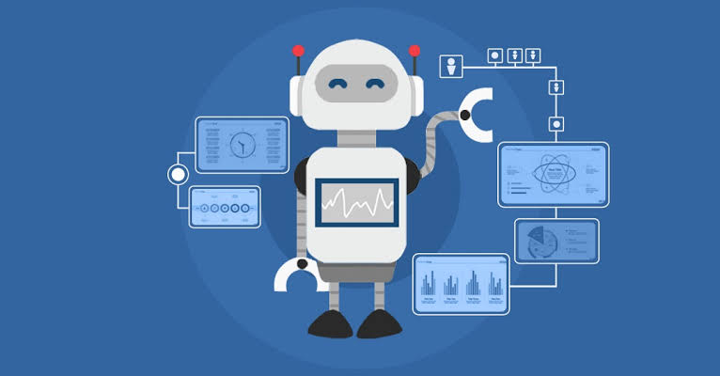
SYSTEM/USER REQUIREMENTS CONTRIBUTIONS
There are no perquisites to use our Bot. A link to our web page will be provided all one has to do is to fill in the required details and they are good to go.
Our project is a common user based the only requirement that the user must fulfill is provide the correct credentials and the correct information while having a conversation with the Health Bot.

Slide 13
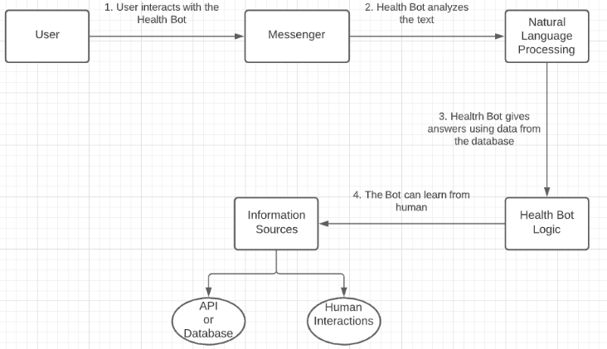
SYSTEM DESIGN
Architecture diagram:

Slide 14
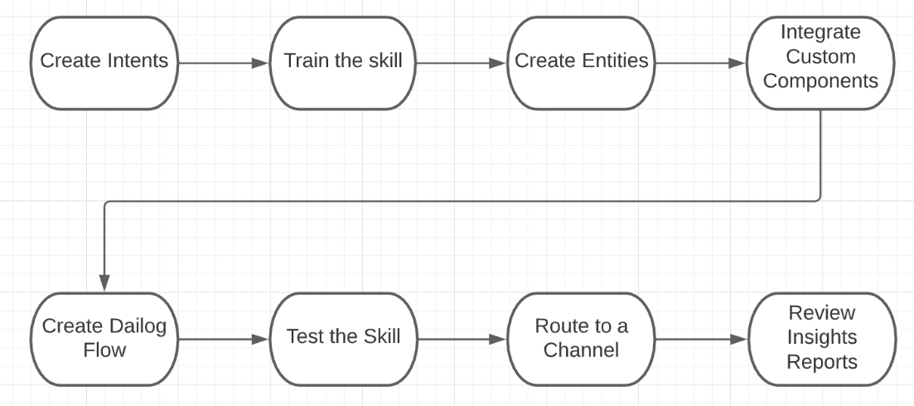
Flow diagram:

Slide 15
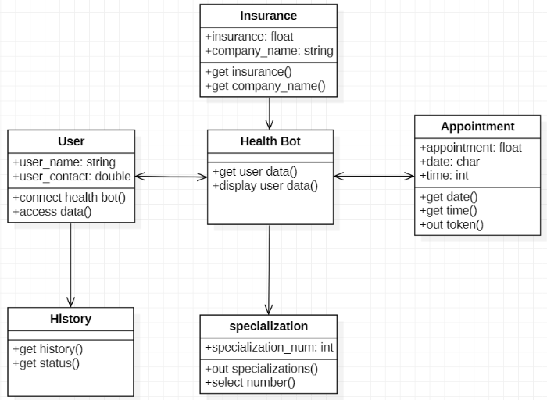
Class diagram:

Slide 16
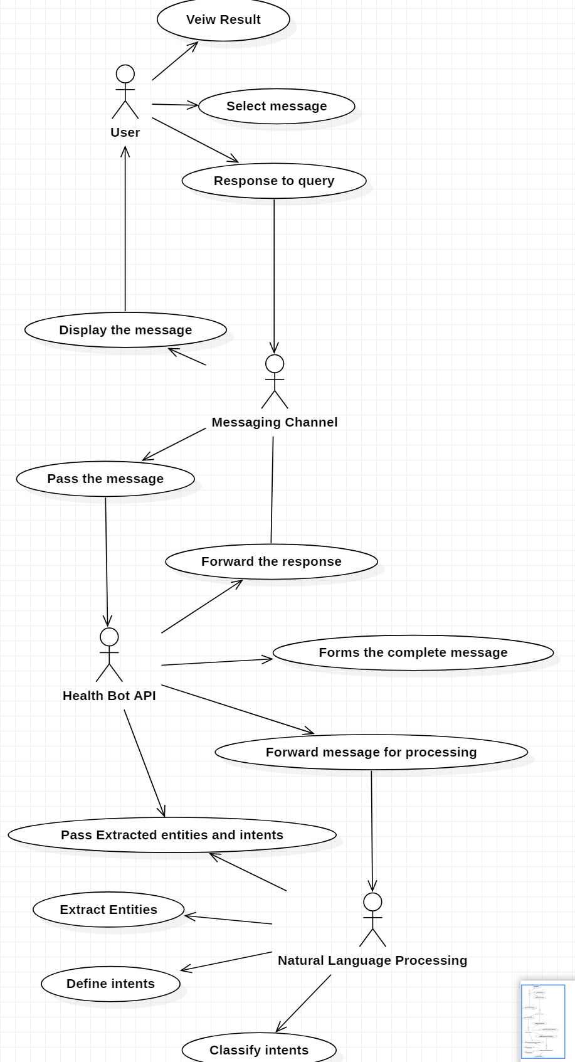
Use case diagram:

Slide 17
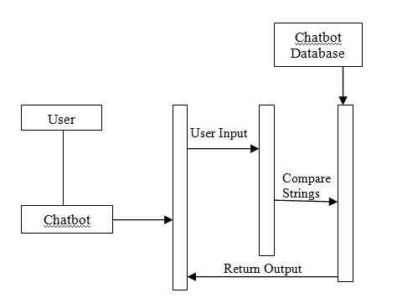
Sequence diagram:

Slide 18
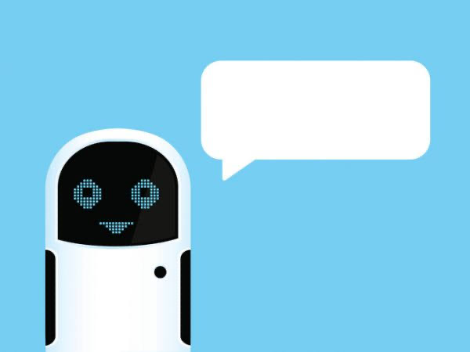
CONCLUSION
Through the proposed project and research, we draw a conclusion that our Health Bot will make booking an appointment and managing of data easy for the consumer and management respectively.
In this Health Bot we build up a system which is useful for the medical institute or hospitals to help the users to freely ask any medical queries

